Slide 1


CSV FILE ANALYZER
A3 10 OOPL Mini Project
Somin Shah(EXCP)-16014023057
Swajeet Salvi(EXCP)-16014023056
KJ Somaiya School of Engineering November 5, 2024

Slide 2
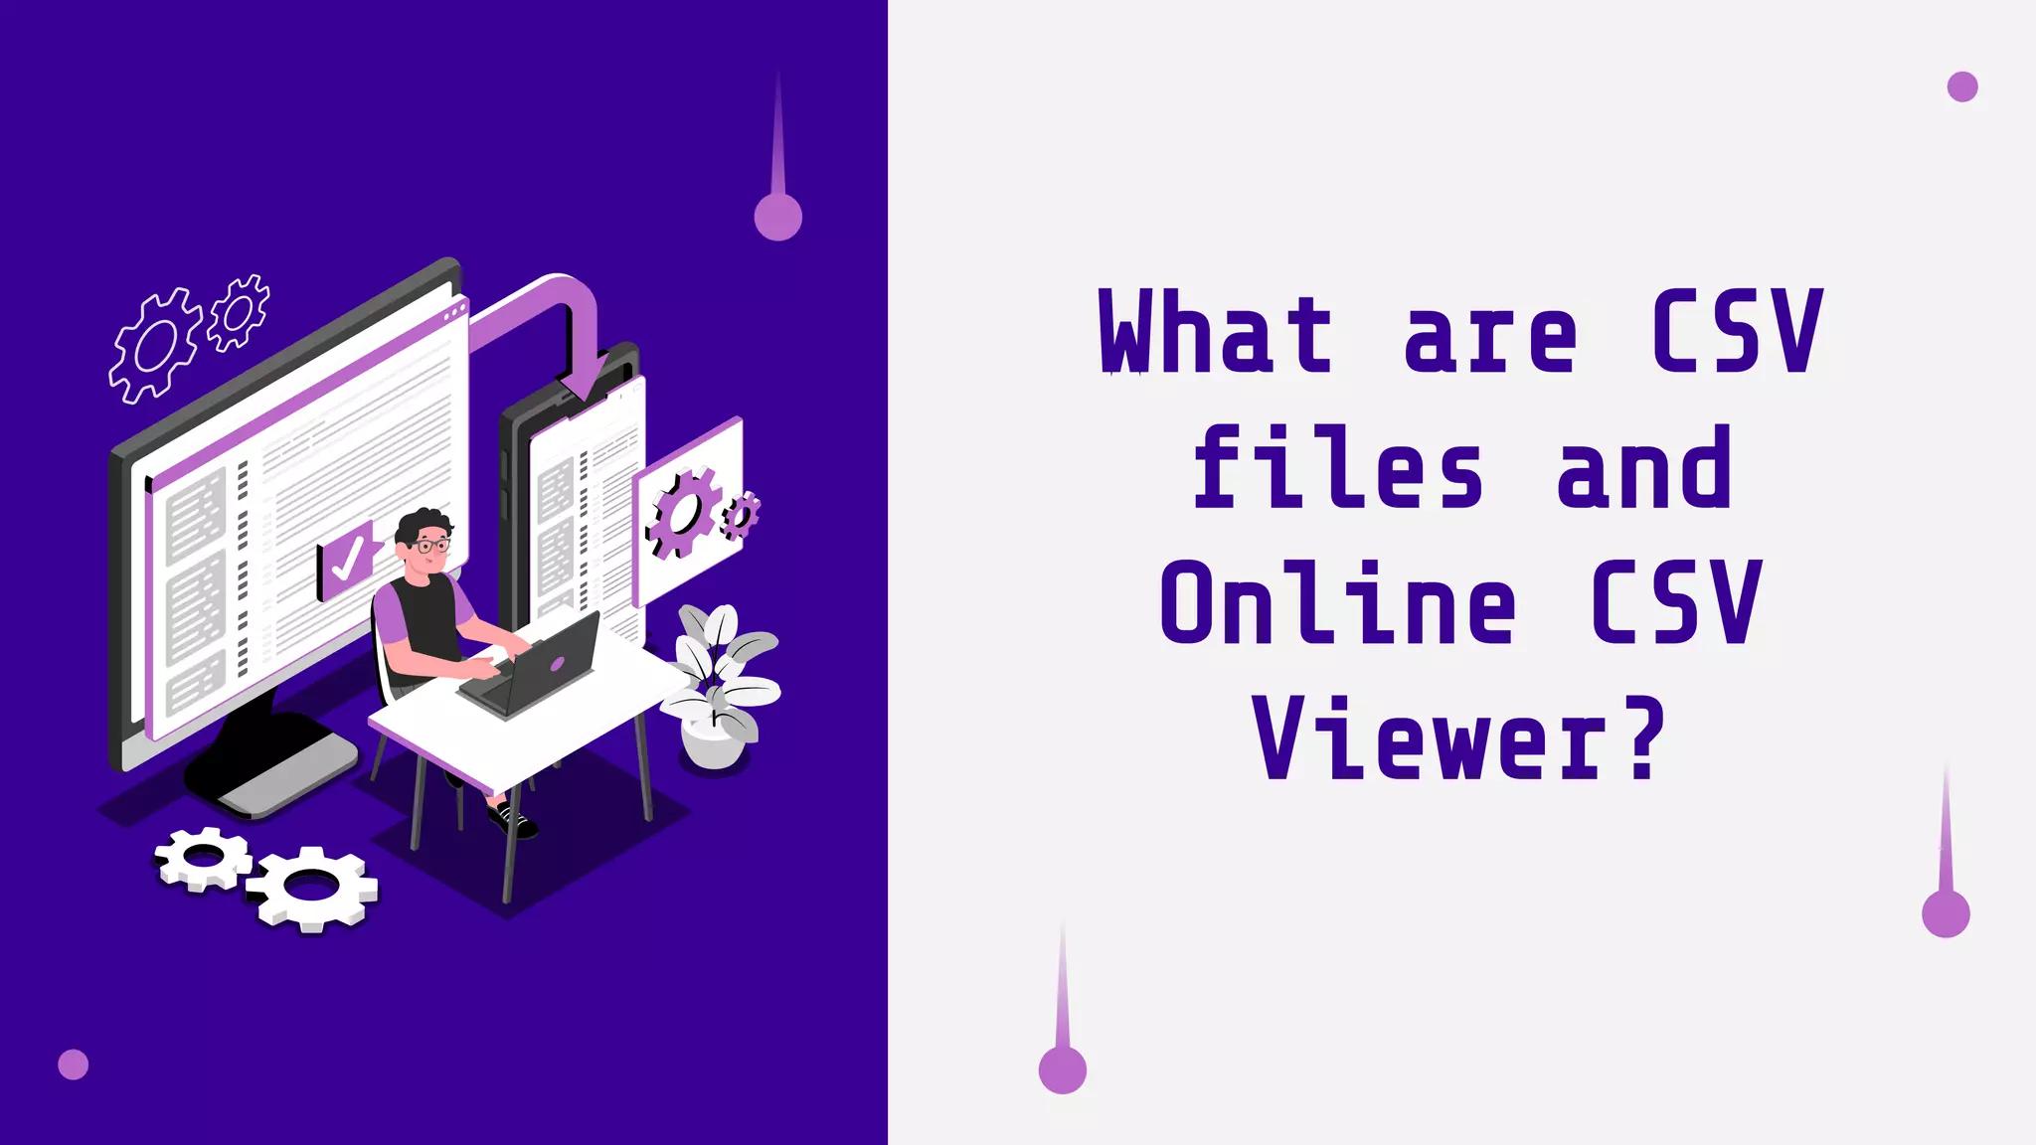

Slide 3
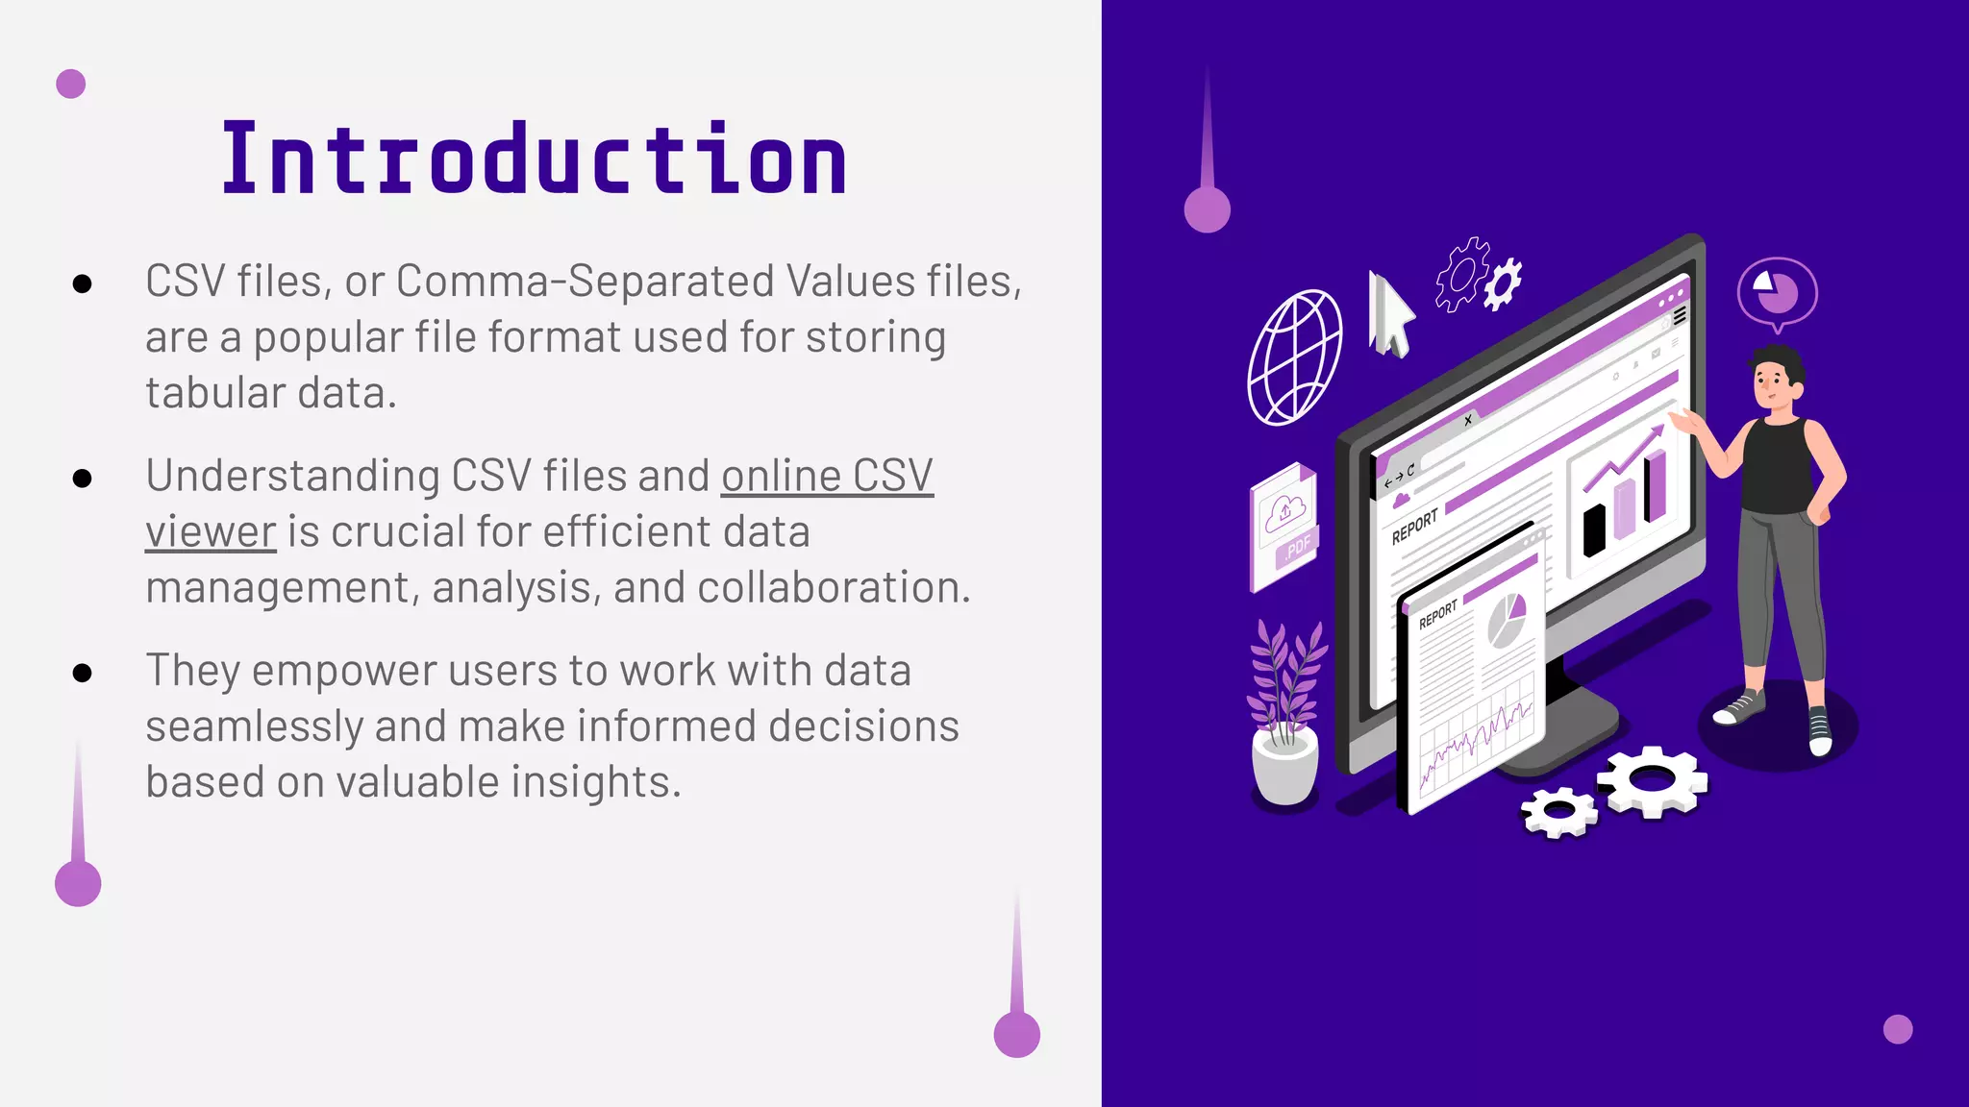

Slide 4
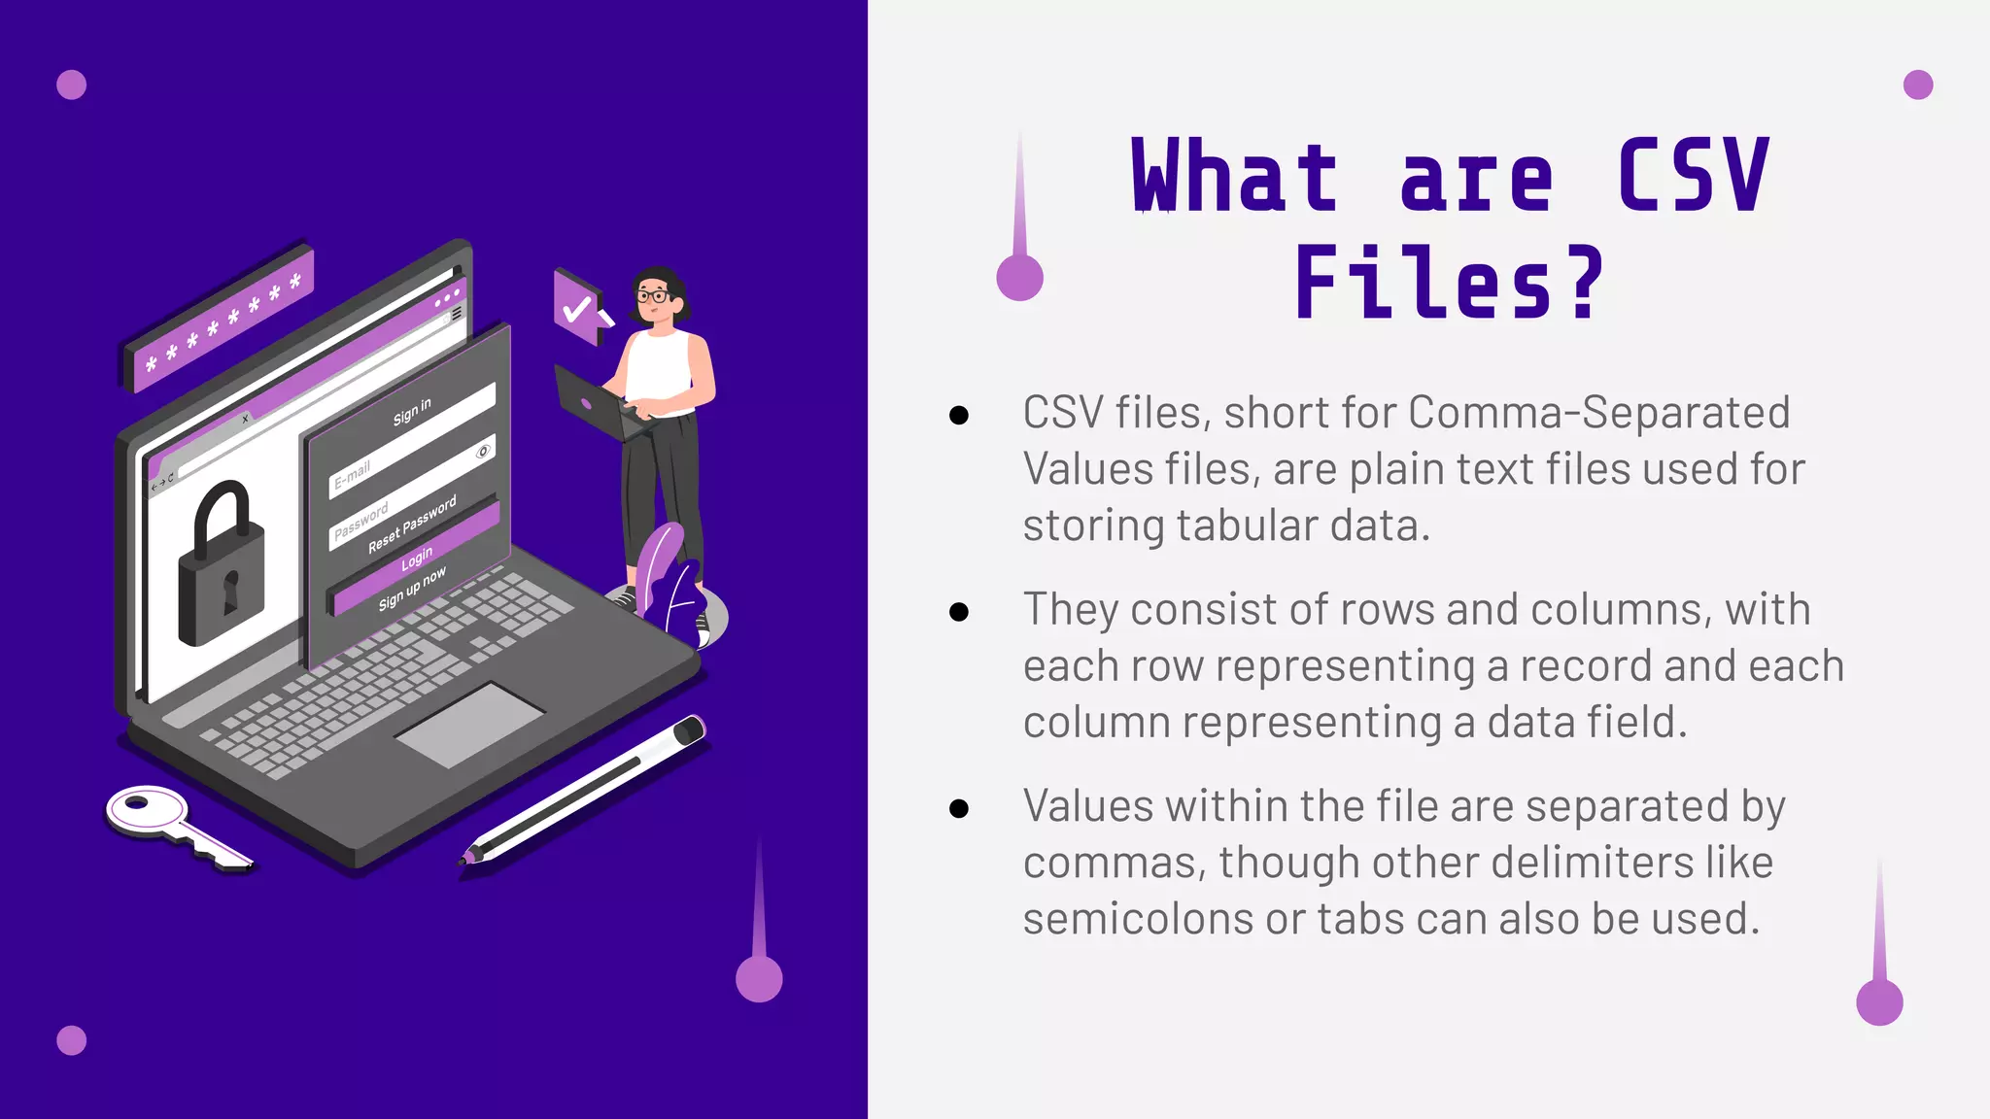

Slide 5
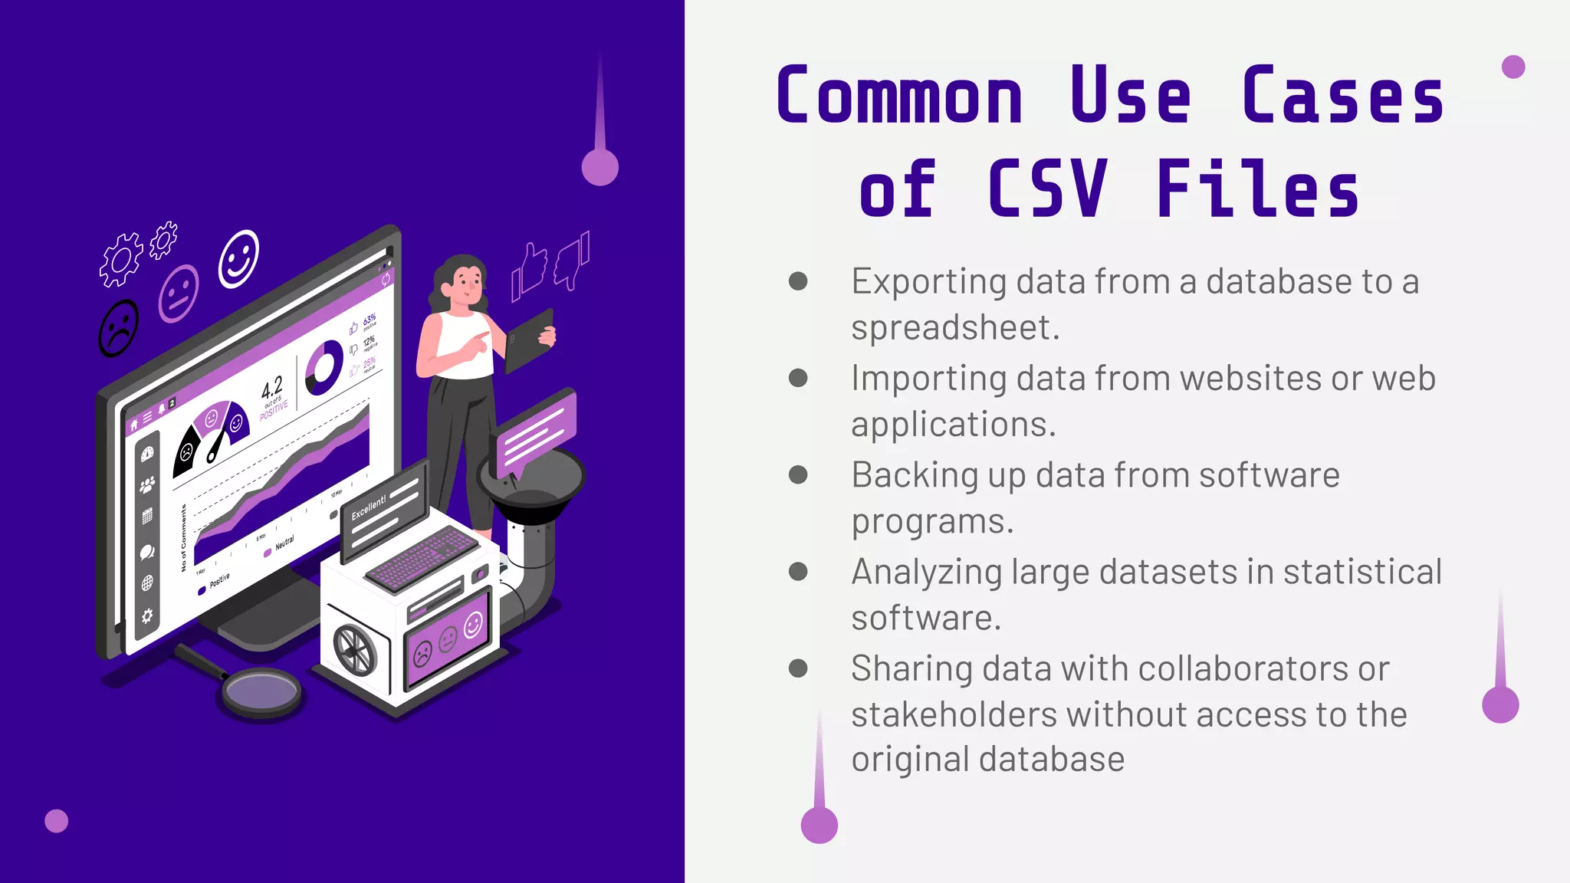

Slide 6
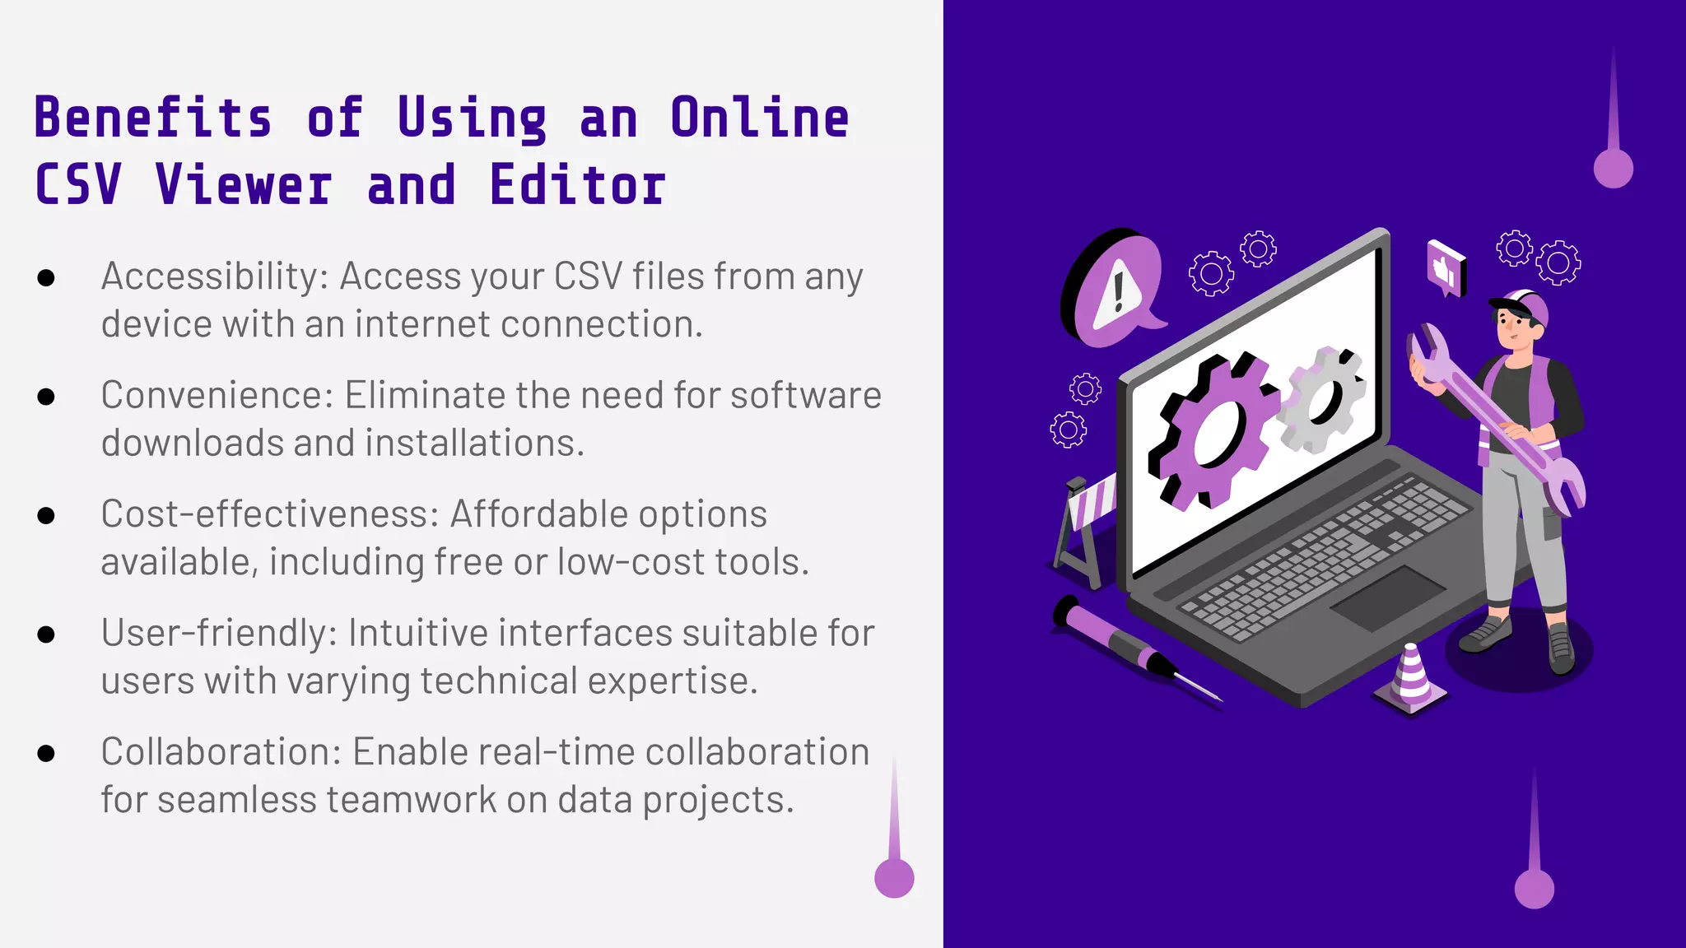

Slide 7
Data Analysis Using CSV File Analyzer
Data Cleaning: Identify and handle missing or erroneous data within the CSV file, such as empty cells, inconsistent formats, and duplicates.
Filtering and Sorting: Allow users to sort data by columns or filter specific entries based on conditions (e.g., values greater than a threshold).
Statistical Calculations: Implement basic statistics like mean, median, max, min, and sum for numerical data columns.
Data Aggregation: Summarize data by grouping entries (e.g., by category or date) and calculating aggregate values like totals or averages.
Data Visualization: Add basic charts (bar, line, pie) using Java libraries (e.g., JFreeChart) to visually represent trends in the data.
Search Functionality: Implement search options to locate specific entries or patterns within the CSV.

Slide 8
REGRESSION’S USED
Linear Regression
Linear regression is a statistical method used to model the relationship between a dependent variable and one or more independent variables. It estimates the best-fitting line through data points, allowing predictions and insights about trends, correlations, and the strength of relationships in the data.
Logistic Regression
Logistic regression is a statistical method for modeling binary outcomes based on one or more independent variables. It estimates the probability that a given input belongs to a particular category, using a logistic function to map predicted values to a range between 0 and 1, facilitating classification tasks.

Slide 9
JSwing
JSwing is a part of Java’s Standard Library for building graphical user interfaces (GUIs).
Allows creation of interactive applications with a wide range of GUI components.
Purpose in CSV Analyzer:
Provides a user-friendly interface for loading, viewing, and interacting with CSV files.
Enables users to navigate and analyze CSV content visually.
Key Components:
JFileChooser: Allows users to select CSV files from their system.
JTable: Displays CSV data in a structured table format.
JButton: Handles actions like "Load", "Clear", and "Export".

Slide 10
Event Handling
Uses event-driven programming for actions (e.g., file loading and row selection).
ActionListener for buttons and TableModelListener for dynamic table updates.
Benefits of Using JSwing:
Enhances interactivity and usability for non-technical users.
Simplifies the process of data loading and visualization.
Example Workflow:
User opens the app → chooses a file with JFileChooser → CSV loads into JTable → data is ready for analysis.
Limitations:
Swing is not as modern as JavaFX but is still widely used for simple applications.
Limited visual customization without additional styling libraries.
Practical Applications:
Ideal for data analysts and developers needing lightweight CSV analysis tools.
Used in educational tools and quick data inspection applications.

Slide 11
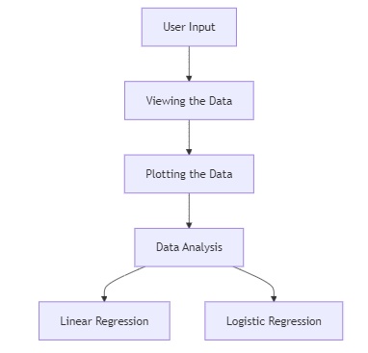
FLOWCHART

Slide 12
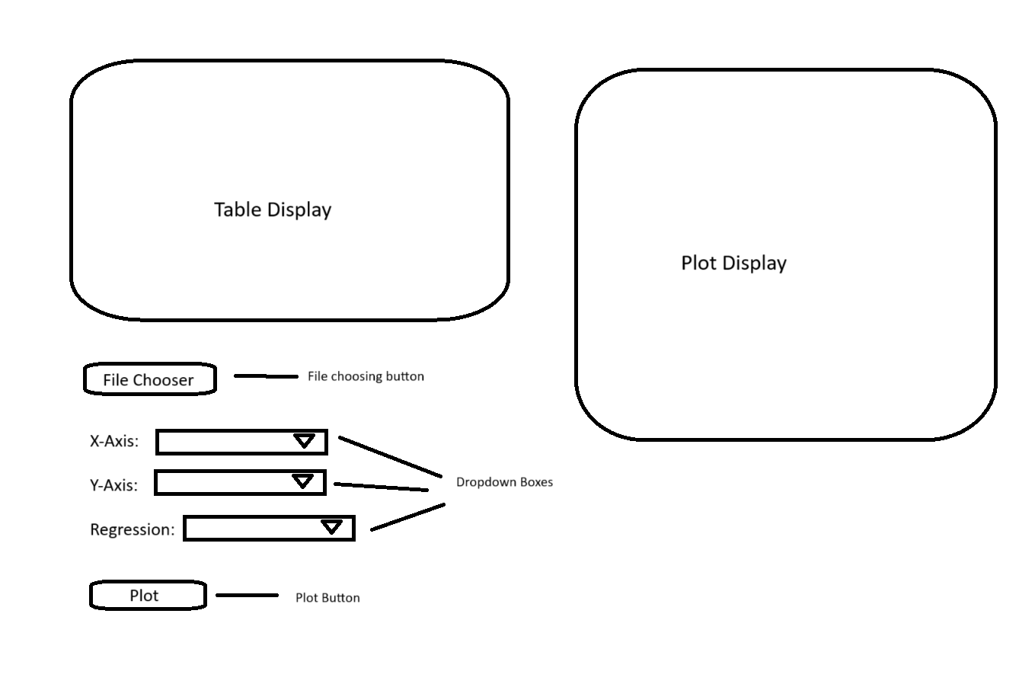
BLUEPRINT

Slide 13
CHALLENGES
Plotting the graph: There were multiple issues in plotting the graph as sometimes the data was not full converted to an array or some other technical issue.
Data analysis: Since the functions for the regression model were manually written, there were some issues in making sure whether the model were correct.

Slide 14
TESTING
1) File Choosing: It was important to make sure that JFileChooser was working properly and was able to import a CSV file correctly.
2) Plotting: After importing the CSV file, it is important to ensure that a correct and accurate graph is plotted and also based on the columns chosen by the user.
3)Multiple plotting: It was also important to make sure that a different plot can be generated without having to re-run the project, whether it is selecting a new column or a completely new CSV File.
4)Data Analysis: It was important to make sure that both the model were working properly and that there graphs are also shown properly.

Slide 15
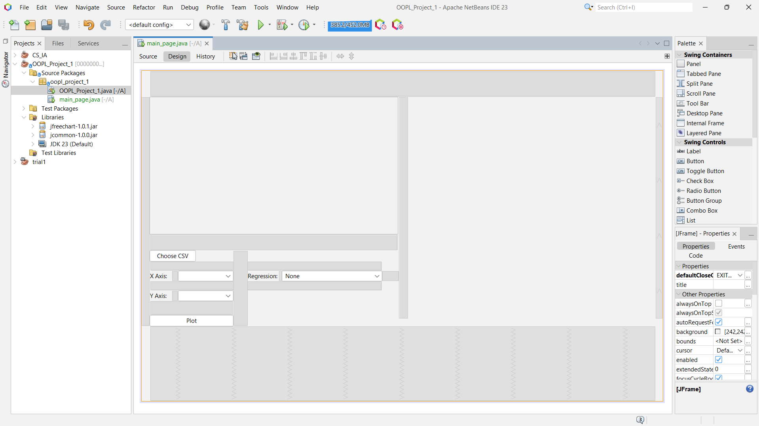

Slide 16
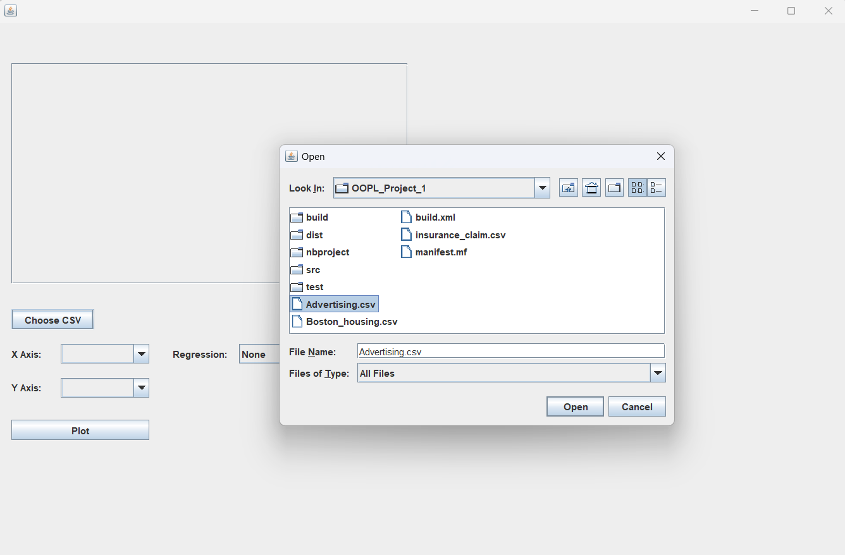

Slide 17
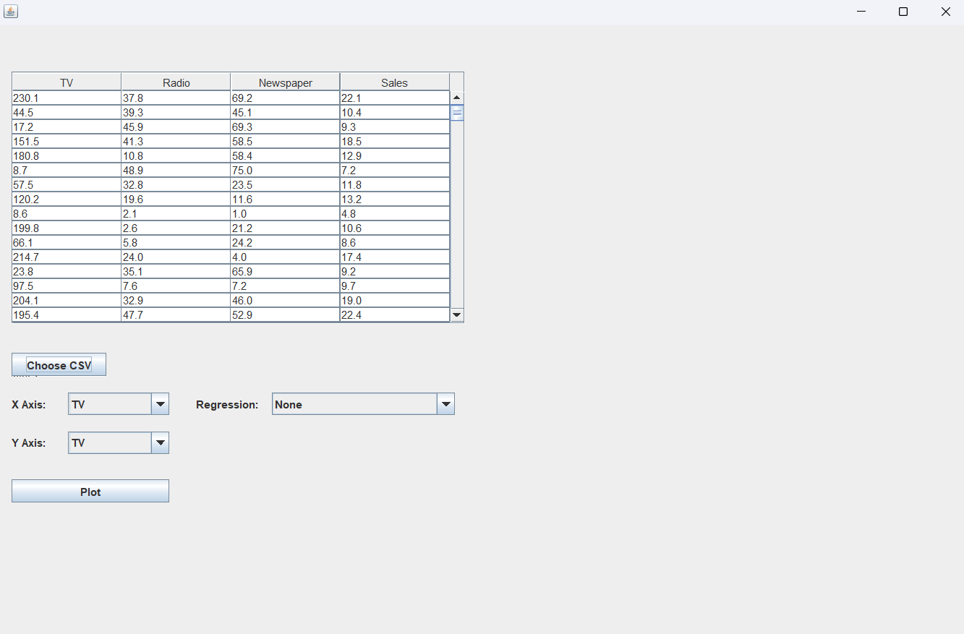

Slide 18
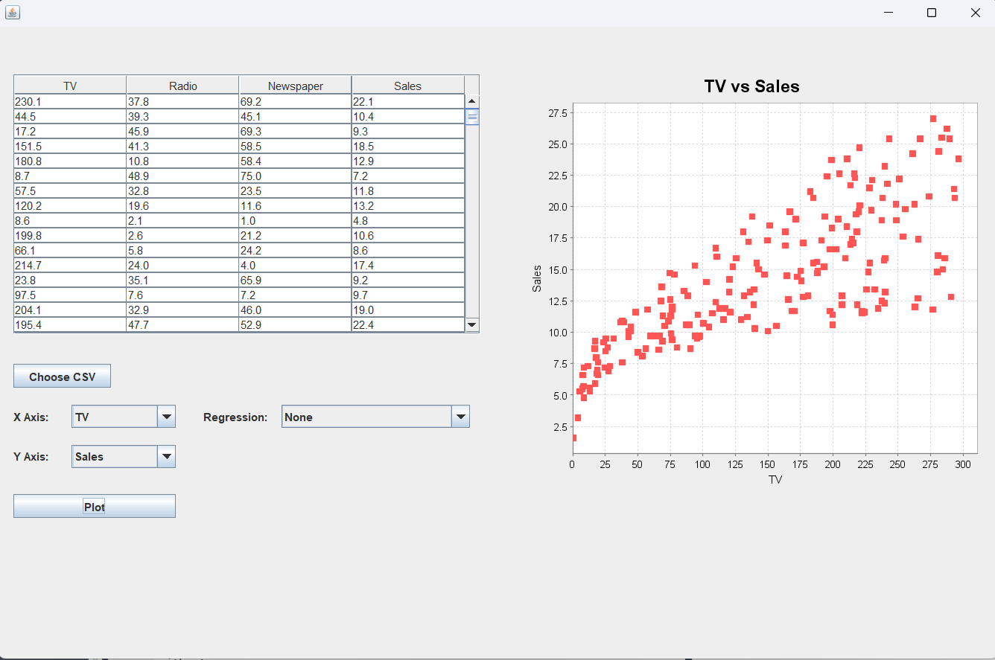

Slide 19
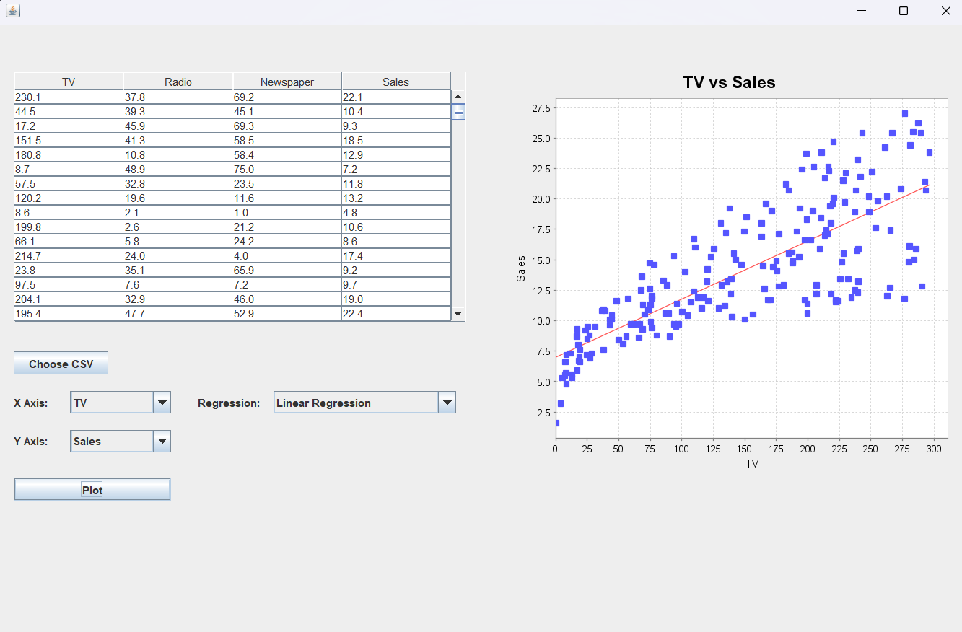

Slide 20
SUMMARY
This prototype is able to meet the expectations and standards that were set before developing it. It is now able to be a productive tool for users allowing them to efficiently analyze data. It can prove to be an incredible time saver, prevent ing repetitive programming. Linear regression and logistic regression are two of the most common models used by Data analysts, especially beginners. This allows them to learn better and apply their skills at a more efficient scale.

Slide 21
FUTURE DEVELOPMENTS
1. AI-Driven Insights and Recommendations
Automated Insights Generation: Use AI to automatically generate key insights from the data, such as trends, anomalies, or patterns that may be of interest.
Personalized Recommendations: Provide personalized data transformation or analysis suggestions based on the user’s past actions or common workflows in similar data.
Anomaly Detection: Implement AI algorithms to detect outliers or unusual data patterns and alert users to investigate these anomalies.
2. Natural Language Processing (NLP) Interface
Chatbot Assistance: Integrate a chatbot within the tool to let users ask questions about their data in natural language (e.g., "Show me the highest sales in 2021").
Voice Commands: Add voice recognition to allow users to perform actions or queries by speaking, making it easier to interact with the data without needing to click.
Automatic Data Summarization: Use NLP to summarize large datasets in plain language, highlighting key statistics and trends in a readable format.
3. Augmented Reality (AR) and Virtual Reality (VR) Integration
AR Data Visualization: Allow users to view 3D data visualizations in augmented reality, where data points and trends are displayed in the physical world via AR glasses or mobile devices.
VR Collaboration: Enable users to enter a virtual environment where they can collaboratively analyze and manipulate data in 3D space, providing an immersive experience.

Slide 22


